Slide 1
Agile Methodology
Implementing Agile Methodology into ChadaTech
By Taylor Hernandez
CS250 Professor Chataut

Slide 2
Agile Roles

Slide 3
Roles in Agile Methodology
Product Owner (PO)
The Product Owner (PO) takes on the responsibility of defining and prioritizing the product backlog, comprising a list of features or user stories to be developed. Their role involves ensuring that the development team fully comprehends the product requirements and that the resulting solution aligns with the customer's needs.
Oversees the team to ensure they are developing the appropriate product.
Scrum Master (SM)
The Scrum Master (SM) plays a pivotal role in facilitating the Scrum process, overseeing the adherence to Agile principles by the team, and addressing impediments that hinder the team's progress. Additionally, the SM contributes to enhancing the team's processes and communication.
Oversees the team to ensure they are adhering to the Agile process and are capable of efficiently delivering the product.
(Schwaber & Sutherland, 2020 paragraphs 2 and 3 of Scrum Team Roles)
Notes:
The reasons as to why each role is important are highlighted but, The Product Owner (PO) oversees the team to ensure they are developing the appropriate product. The Scrum Master (SM) oversees the team to ensure they are adhering to the Agile process and are capable of efficiently delivering the product.

Slide 4
Roles cont.
Development Team
Developers and Testers
The development team is comprised of cross-functional members who collaborate to create the product. Their collective responsibility is to produce functional software by the conclusion of each sprint.
Ensures that the product is constructed accurately and fulfills the customer's requirements.
(Schwaber & Sutherland, 2020 paragraph 1 of Scrum Team Roles)
Notes:
The importance of the development team is The development team ensures that the product is constructed accurately and fulfills the customer's requirements.

Slide 5
Agile Phases

Slide 6
Sprint Planning
During Sprint Planning, the Scrum Team collaboratively lays out the work for the Sprint. The Product Owner ensures readiness to discuss important Product Backlog items and their alignment with the Product Goal. Without Sprint Planning, there is not direction for the team to drive the product towards.
Why is this Sprint valuable?
Product Owner proposes ways to increase product value
Scrum Team collaborates to define Sprint Goal
Sprint Goal communicates value to stakeholders
Sprint Goal must be finalized before end of Sprint Planning
(Schwaber & Sutherland, 2020 paragraph 5-11 of Scrum Events)

Slide 7
Sprint Planning Cont.
What is Done in a Sprint?
The Scrum team selects items from the Product Backlog for the current Sprint after discussing with the Product Owner.
Refining the selected items increases understanding and confidence.
Estimating how much work can be completed within a Sprint can be challenging.
Developers should consider their past performance, upcoming capacity, and Definition of Done to improve the accuracy of their Sprint forecasts.
How does work get done?
Developers plan the work for each Product Backlog item to create an Increment that meets the Definition of Done
They decompose items into smaller work items of one day or less at their discretion
Sprint Goal, selected Product Backlog items, and the plan for delivering them make up the Sprint Backlog
Sprint Planning is timeboxed to a maximum of eight hours for a one-month Sprint, with shorter Sprints having a shorter event
(Schwaber & Sutherland, 2020 paragraph 5-11 of Scrum Events)

Slide 8
Sprint and Daily Scrum
The team implements tasks and items planned during Sprint Planning.
It entails developers and testers adhering to the laid out guidelines to ensure a fully developed product by the end of the sprint.
Daily "Daily Scrums" meetings during the sprint
Meetings aim to communicate and resolve any issues hindering sprint completion
Changes may also occur and it is important to have the Scrum to adapt focus of the product.
*The sprint allows the team to focus on delivering working software.
*Daily Scrum ensures that the team is on track and addresses any issues promptly.

Slide 9
Sprint Review
At the end of the sprint, the team meets up to review the work done during the sprint and receives feedback from stakeholders.
The progress towards the product goal is also assessed.
The Product Backlog may also be adjusted to meet new opportunities.
The Sprint Review is a working session
*The sprint review guarantees that the team obtains feedback and can subsequently make adjustments to the product.

Slide 10
Sprint Retrospective
The Scrum Team evaluates the previous Sprint to identify what went well and what didn't.
They then discuss potential improvements to enhance effectiveness.
*Sprint retrospective ensures that the team continuously improves their processes.

Slide 11
The Waterfall Method

Slide 12
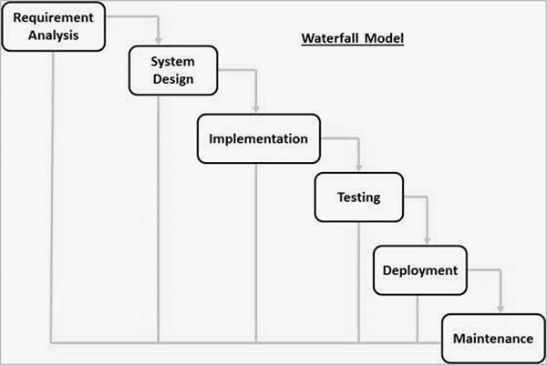
What is the Waterfall Method?
The Waterfall Model is the first Process Model
It follows a linear-sequential life cycle
Each phase must be completed before the next phase can begin
There is no overlapping in the phases
(n.a., SDLC - Waterfall Model n.d)

Slide 13
What Would SNHU Travel Be in Waterfall Application?
Waterfall method is rigid and follows a linear process
Project is not fleshed out into a working physical product until the end
Team may not know what implementations work until the end
Any issues require starting over, leading to multiple iterations before a usable product is produced
The project would have allowed for simpler application rather than complex such as use of multiple tabs, buttons etc.
The Project would have been hard to follow and caused low team morale with a lack of direction

Slide 14
Waterfall or Agile?

Slide 15
Main Factors to Consider
Project Complexity: How complex do we want to make the product?
For the requirements of SNHU Travel, the final project will be complex.
Simple projects are better suited for the Waterfall method
Customer Involvement: How involved do we want the customer/stakeholders to be?
In regards to the team, the stakeholders are heavily involved
The waterfall allows for minimal involvement of the customers/stakeholders
Team Size and Distribution: How large is our team?
Our team is small.
Using waterfall is better suited for larger teams
Change Tolerance: How often will changes be needed?
For the complexity of the project, we change often.
Minimal change is better suited for Waterfall and the current project does not allow for that

Slide 16
Our Team Should Use…
Considering the project requirements, the Agile methodology would be a better fit for our team. This is because of the numerous changes to the user interface, travel types, and other elements, which would have been difficult to accommodate using the waterfall methodology. Agile is well-suited for complex projects that necessitate adaptability and cooperation, while Waterfall is more appropriate for straightforward projects with clearly defined requirements. Implementing each of these requirements requires using waterfall applications for each individual aspect would consume more time than is allotted for the project(Cobb, 2015). The involvement of the stakeholders is also drastically reduced in the Waterfall method and would not suit our team.

Slide 17
References
Agile Requirements Change Management. The Agile Modeling (AM) Method - Effective Strategies for Modeling and Documentation. (2023, November 23). https://agilemodeling.com/essays/changeManagement.htm
Charles G. Cobb. (2015). The Project Manager’s Guide to Mastering Agile : Principles and Practices for an Adaptive Approach. Wiley.
Schwaber, K., & Sutherland, J. (2020). The 2020 scrum GUIDETM. Scrum Guide | Scrum Guides. https://scrumguides.org/scrum-guide.html#scrum-team
SDLC - Waterfall Model. Tutorialspoint. (n.d.). https://www.tutorialspoint.com/sdlc/sdlc_waterfall_model.htm

